Slide 1

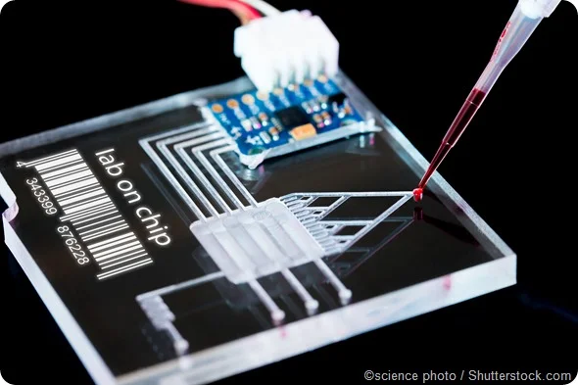

Team 78: Interdigitated Electrodes in Microfluidics
Bi-Weekly Update 2 Erin Ingram and Omar Mahmood Sponsor: Dr. Arum Han, Dr. Han Zhang TA: Dalton Cyr
Notes:
Omar

Slide 2
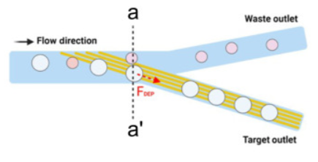
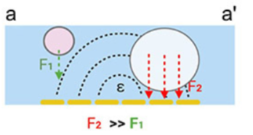
Project Summary
Mitigating satellite droplets in microfluidic “lab-on-a-chip” devices that lead to false test results in drug screenings, disease diagnostics, DNA analysis applications
Using interdigitated electrodes (IDEs) to perform size-based filtration on microfluidic droplets
Notes:
Omar

Slide 3
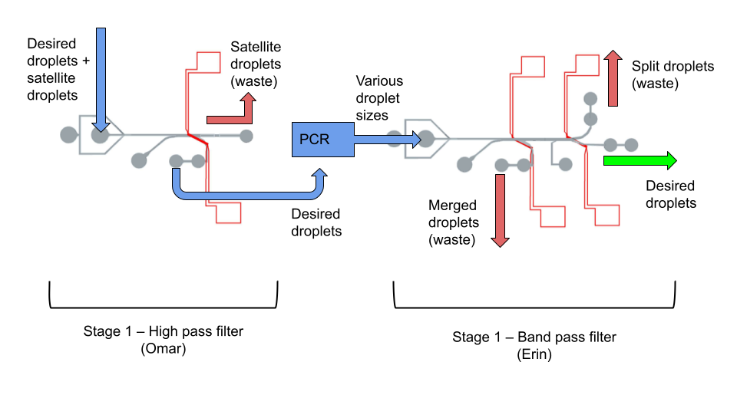
Project/Subsystem Overview
Diagram showing subsystems – with labels showing subsystem owners
Bullets giving essential system/subsystem characteristics
If major changes in subsystems, show before and after … see next slide
Notes:
both

Slide 4
Project Timeline
Fabrication
Preliminary Validation
Experiments & statistical analysis
Component Optimization
Validation of whole device
High level figure showing where you are at in the project, what’s completed, what’s underway – it should take about 30 seconds to summarize where you are in the timeline
-- Save discussion for subsystem update
-- Save detail for execution plan & validation plan status
Fabricated High Pass Filter
Fabricated Band Pass Filter
Fabricated IDE’s
No leakages or blockages
High Pass filter sorts within acceptable range
Band Pass filter sorts within acceptable range
Test different voltages
Test different IDE parameters
Use image processing software
Refabricate IDE’s if needed
Design new channels if needed
Decide on IDE parameters
Run whole system together
Test droplet maneuverability between filters
Notes:
erin

Slide 5
Subsystem 1: High Pass Filter
Omar
Accomplishments since 403 6 hrs of effort | Ongoing progress/problems and plans until the next presentation
Designed and printed corrected channel Simulated electric field heights for future experiments Planned experiments Started on image processing | Complete analysis using Fiji Conduct experiment using varying voltages
Notes:
omar

Slide 6
Subsystem 2: Band Pass Filter
Erin
Currently working on: 6 hours of effort since 403 | Plan for next 2 weeks:
Image processing to get statistics on how well my previous experiment went Designing experiments to investigate voltage vs flow rate, IDE size/spacing | Progress on experiments Image process results from voltage experiments
Notes:
erin

Slide 7
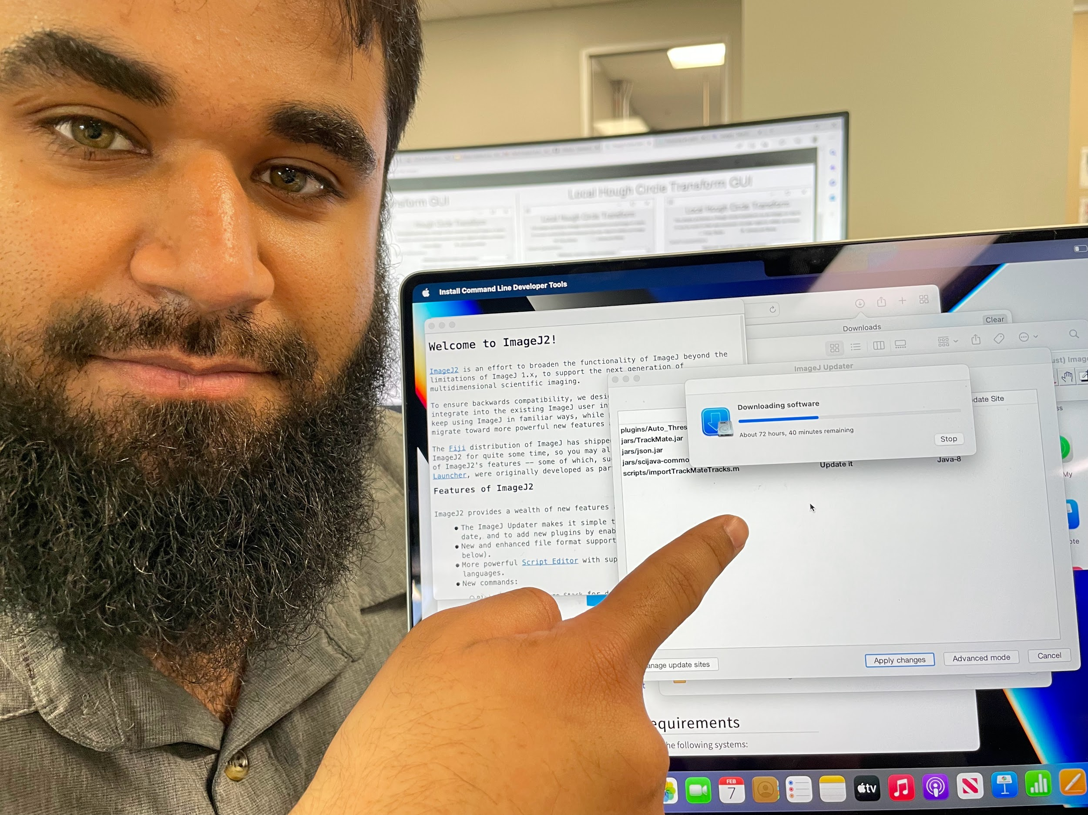
Image Processing
Unforeseen difficulties
Lab personnel
Download time

Slide 8
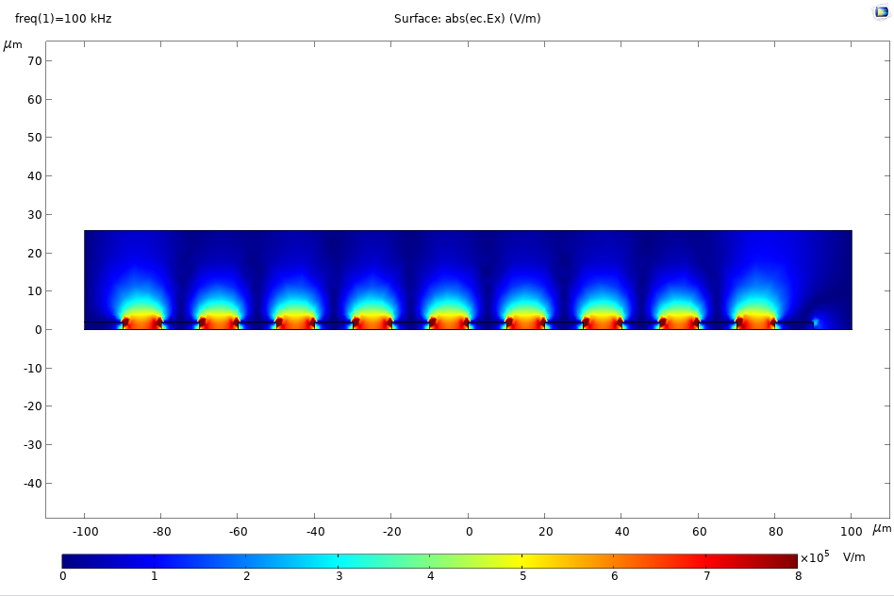
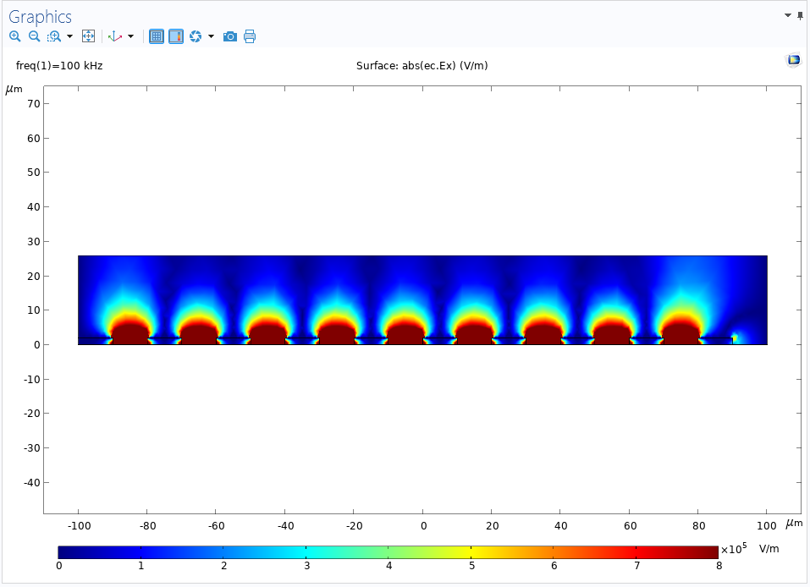
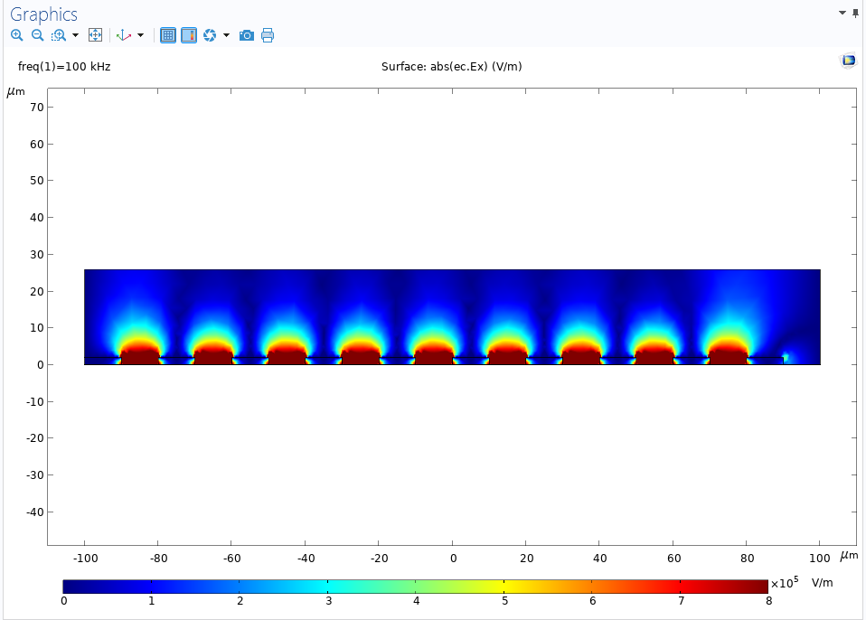
Sample Simulation Results
V = 0.5V
V = 1.0V
V = 0.75V
Notes:
omar

Slide 9
Experimental Plans
For both subsystems
Voltage vs flow rate
As voltage increases, need to increase flow rates to carry heat out of the system more quickly, avoid burning up IDEs
Test multiple voltages and see what flow rates are most effective against each voltage – create plot of this
Can’t plan what voltages to test in advance
How much voltage the IDEs can take depends on fabrication – need to standardize our next fabrication process
Start at 0.5 V and go from there
10um IDE control
Notes:
erin

Slide 10
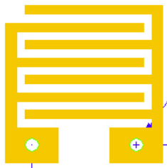
Experimental Plan, cont.
IDE size/spacing
Simpler experimental plan
Test filtration using 5um, 10um, 20um IDEs
Hold voltage constant at 0.5 V
Notes:
omar

Slide 11
Execution Plan
Date | Accomplishment
February 22 | Complete image processing on our previous experiments At least one experiment
March 8 | Continue experiments
March 22 | Continue experiments
April 5 | Image analysis on all experiments Thesis final installment
April 19 | Finalize optimal device design
May 3 | Validation of entire system
Notes:
erin

Slide 12
Validation Plan
Things we need to do: | Progress | Subsystem
Image processing on preliminary validation experiments |  | Both
Voltage experiment: 0.5V |  | Both
Voltage vs Flow Rate experiment 1 |  | Both
Voltage vs Flow Rate experiment 2 |  | Both
Voltage vs Flow Rate experiment 3 |  | Both
IDE experiment: 5um |  | Both
IDE experiment: 10um |  | Both
IDE experiment: 20um |  | Both
Image processing on all voltage and IDE experiments |  | Both
Determine best voltage & IDE combo |  | Both
Final experiments with best parameters |  | Both
Notes:
erin

Slide 13
Thank you!
Questions?

